Slide 1



Fine-Grained Visual-Language Model with Disease Mapping for Long-tailed X-Ray Chest Image Zero-shot Classification
-- 2nd Place in MICCAI 2024 Task 3 Challenge
Ruichi Zhang¹, Yang Zhou², Yang Lu¹
¹ School of Informatics, Xiamen University
² IHPC, A*STAR, Singapore
Notes:
Hello everyone. I’m here to present our work, 'MMS: Morphology-mixup Stylized Data Generation for Single Domain Generalization in Medical Image Segmentation.'
This research is a joint effort by Xiaochen He and corresponding author Baoyao Yang from the School of Computers at Guangdong University of Technology, alongside Fei Lyu from the Department of Computer Science at Hong Kong Baptist University.

Slide 2
Overview
The key to enhancing the generalization ability of a zero-shot medical image classification model lies in effectively using existing data to better classify unseen diseases.
We use a Visual-Language Model (VLM) to connect visual features with textual descriptions, crucial for zero-shot tasks.
We augment labels with detailed descriptions generated by GPT-4, helping the model understand unseen diseases by learning from similar descriptions of known conditions.
We integrate specific disease locations from CheXpert and map the diseases from the task to anatomical locations, enhancing generalization by modeling fine-grained relationships.
We apply a class-wise ensemble strategy and perform test-time fusion to improve robustness and accuracy in zero-shot classification.
Our method achieved second place in Task 3 of the MICCAI 2024 Challenge.
Notes:
Here is a quick review. The key to address single-source domain generalization lies in increasing the diversity and informativeness of the training samples. In this work, we propose to generate data from a new perspective of morphology, which further enhance the diversity and fidelity of generated data. Specifically, we design a new network that simulate probable morphological structures through a technique, called morphology mix-up. And the proposed method achieves SOTA performance in three cross-domain medical segmentation datasets.

Slide 3
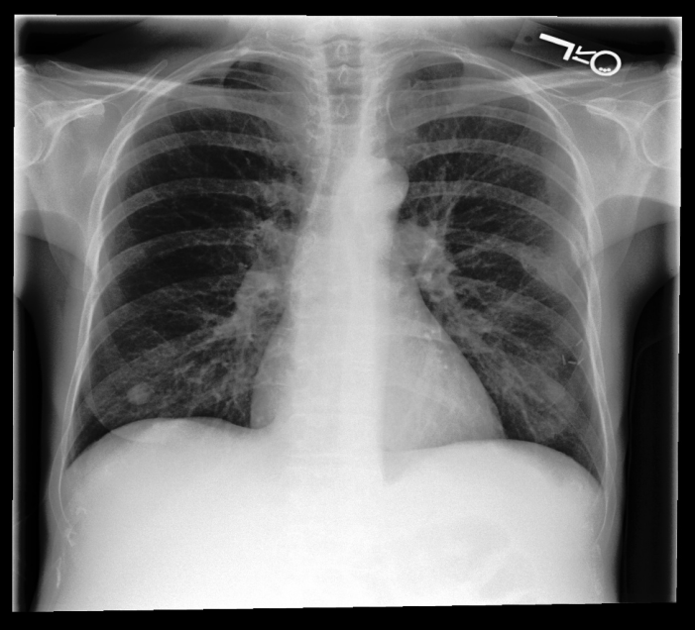
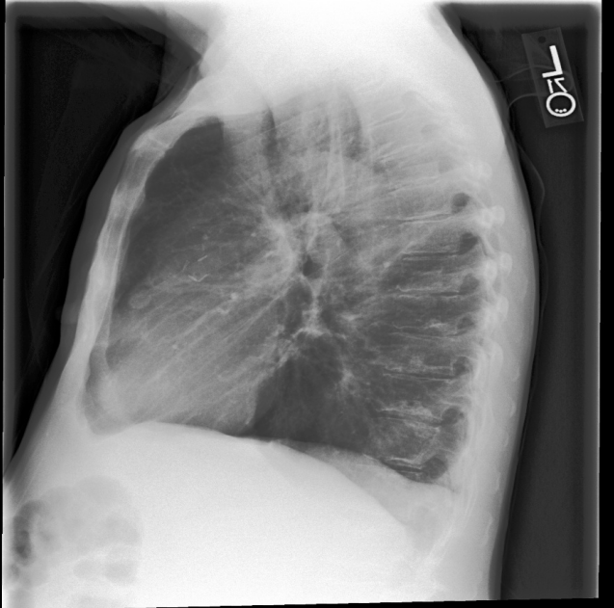
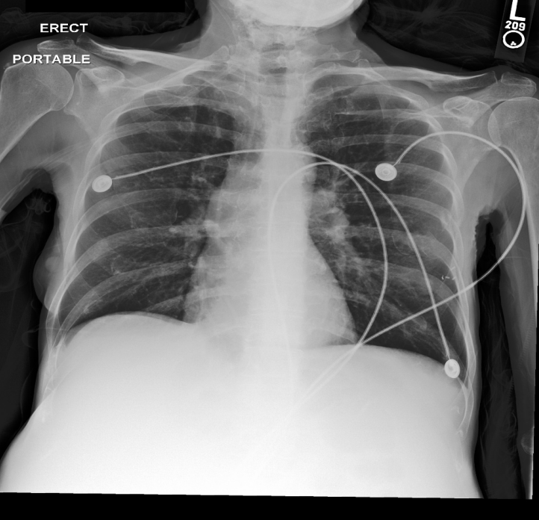
Problem
zero-shot learning
Training
Testing
Adenopathy
Atelectasis
...
...
...
Tortuous Aorta
Tuberculosis
Bulla
Cardiomyopathy
Hilum
Osteopenia
Scoliosis
Notes:
Building on the background we just discussed, we arrive at a specific problem: Single Source Domain Generalization in Medical Image Segmentation. In this scenario, we train a model on data from one source domain, say Center A, and then apply it to other unseen target domains, like Centers B and C. Our goal is to minimize the performance drop when the model is used in these different target domains. We can find that the images from the different centers show discrepancies in the appearance, such as the variations in the imaging angles, and subtle differences in the tissue representation due to the MRI machine's calibration and settings.

Slide 4
Background
Zero-Shot Learning Challenges in Medical Image Classification
Data Limitation
Zero-shot learning requires robust feature representations for unseen diseases.
Gathering extensive labeled datasets is often impractical.
Transfer ability Issues
Knowledge transfer from known to unknown classes is often limited.
Models may not effectively utilize learned representations from seen diseases when encountering new diseases.
Notes:
We begin by discussing the background of our work. Traditional deep learning methods face two major challenges in medical image segmentation. The first one is the data limitation: robust models need extensive and diverse labeled images, which is usually very hard to obtain because of the privacy concerns and the high cost of expert annotations. The second one is called the domain shift. This happens when the training samples don't match the test ones, leading to a drop in model performance. While in healthcare, this issue is very common because different hospitals might use different imaging techniques, equipment settings and scanner models, making the image vary from one site to another.

Slide 5
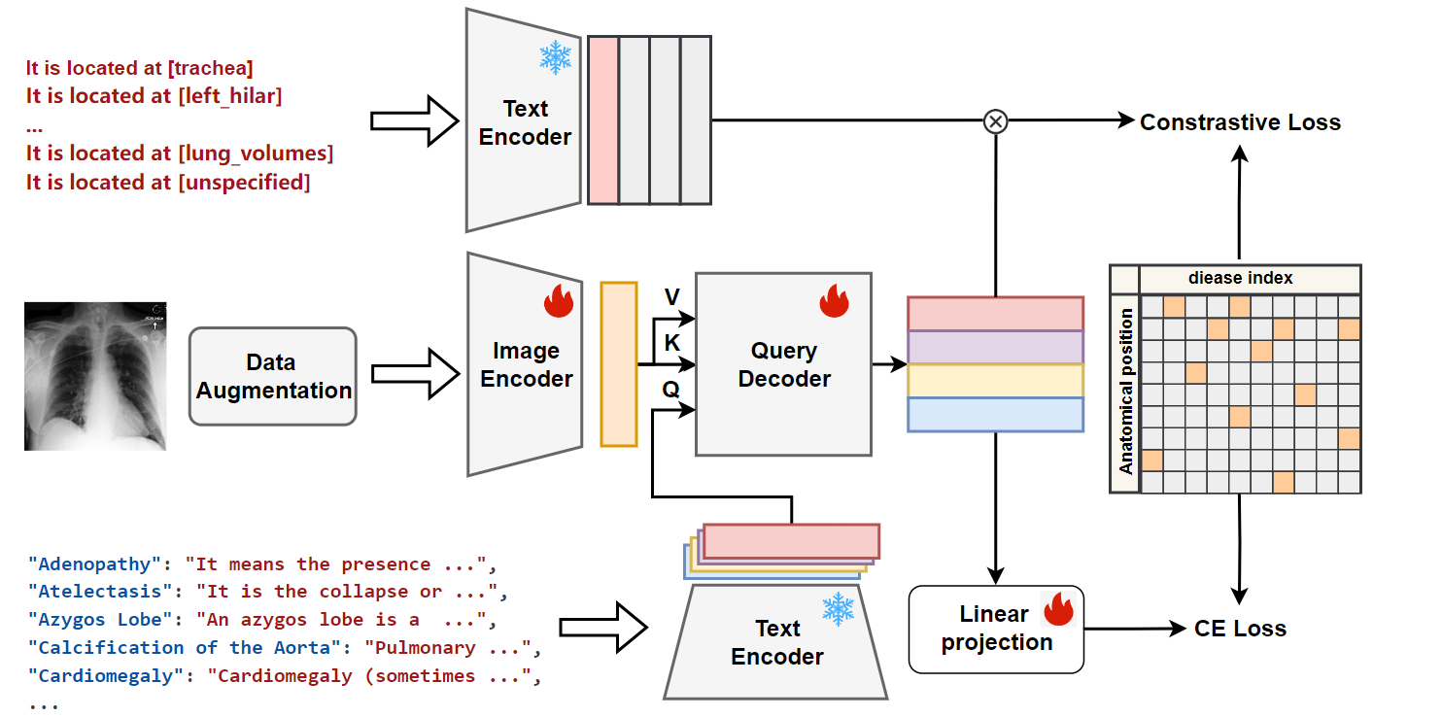
Method
Notes:
The is the framework of our method. It consists of two phases: the training and the domain generalization (DG) phases. In the training phase, a Mixed Dual-stream Auto-Encoder (MDs-AE) is introduced, which comprises an encoder, reconstruction, and segmentation decoder, where features from the reconstructor's layers are fed into the segmentor to enhance segmentation accuracy to enhance the relevance between them. It takes slice pairs as inputs and mixes up their features to generate morphology mix-up images with their corresponding masks. The morphology mix-up images are then projected back to the feature space and enforced to be consistent to the original mixed features to ensure the effectiveness of feature mixing. In the DG phase, the trained MDs-AE is adopted to mix the morphology within a pair of images and the resulting samples are further subjected to style transformation. Finally, the augmented data is employed to train the segmentation model.

Slide 6
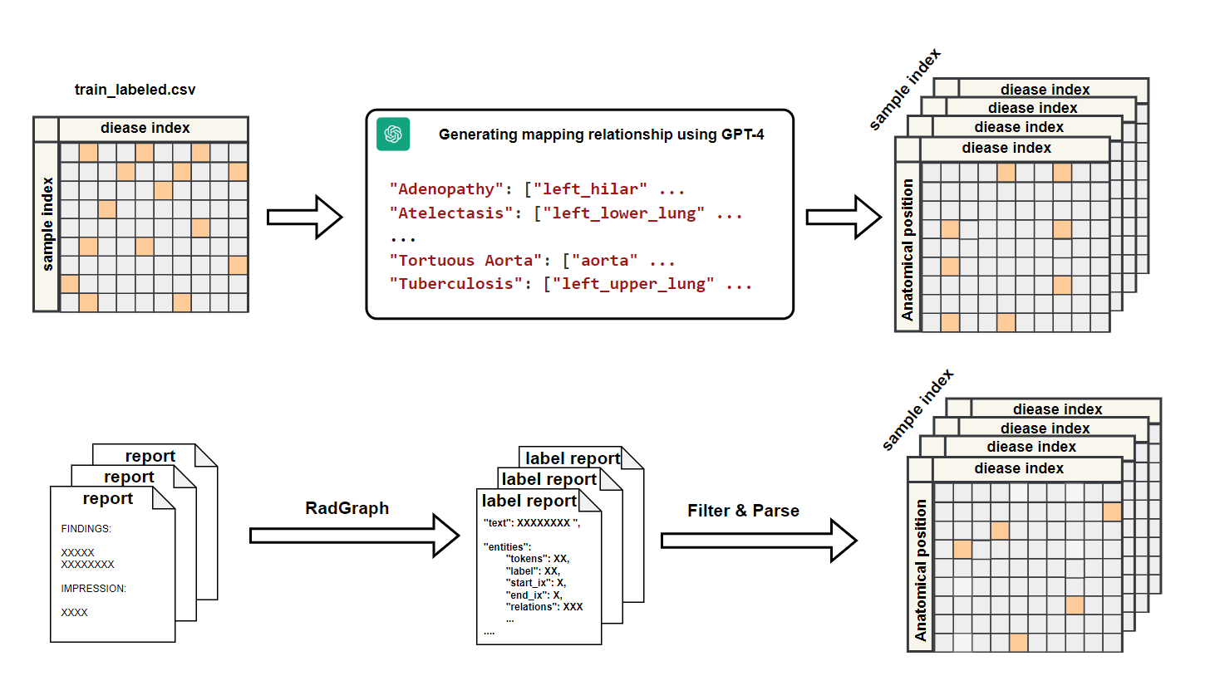
Method
Notes:
The is the framework of our method. It consists of two phases: the training and the domain generalization (DG) phases. In the training phase, a Mixed Dual-stream Auto-Encoder (MDs-AE) is introduced, which comprises an encoder, reconstruction, and segmentation decoder, where features from the reconstructor's layers are fed into the segmentor to enhance segmentation accuracy to enhance the relevance between them. It takes slice pairs as inputs and mixes up their features to generate morphology mix-up images with their corresponding masks. The morphology mix-up images are then projected back to the feature space and enforced to be consistent to the original mixed features to ensure the effectiveness of feature mixing. In the DG phase, the trained MDs-AE is adopted to mix the morphology within a pair of images and the resulting samples are further subjected to style transformation. Finally, the augmented data is employed to train the segmentation model.

Slide 7
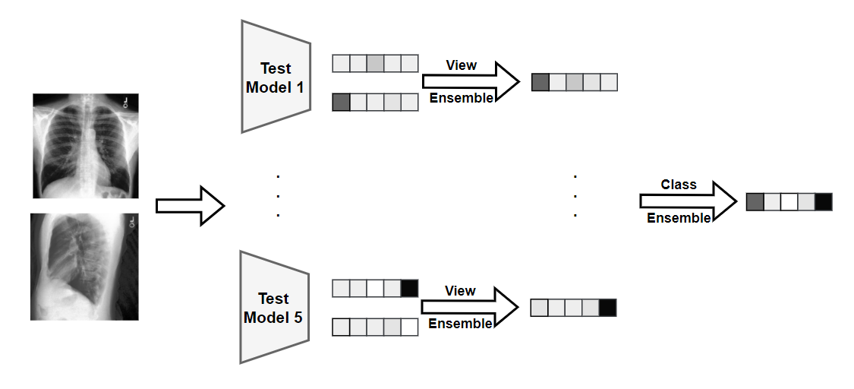
Method
Notes:
The is the framework of our method. It consists of two phases: the training and the domain generalization (DG) phases. In the training phase, a Mixed Dual-stream Auto-Encoder (MDs-AE) is introduced, which comprises an encoder, reconstruction, and segmentation decoder, where features from the reconstructor's layers are fed into the segmentor to enhance segmentation accuracy to enhance the relevance between them. It takes slice pairs as inputs and mixes up their features to generate morphology mix-up images with their corresponding masks. The morphology mix-up images are then projected back to the feature space and enforced to be consistent to the original mixed features to ensure the effectiveness of feature mixing. In the DG phase, the trained MDs-AE is adopted to mix the morphology within a pair of images and the resulting samples are further subjected to style transformation. Finally, the augmented data is employed to train the segmentation model.

Slide 8
Experiment
Datasets and Setting
Details of the use of datasets
Dataset | Disease Labels | Location Labels | View | Image Size
MIMIC-CXR | From Challange | Mapping | PA、AP、LATERAL ... | 224 × 224
CheXpert | RadGraph & Filter | RadGraph & Filter | PA、AP、Lateral ... | 224 × 224
Notes:
Here are the details of cross-domain datasets used in this study. We conduct experiment on three scenarios. a cross-modality dataset with abdominal imaging transitioning between CT and MRI modalities. a cross-sequence cardiac dataset, which examines variations between balanced steady-state free precession (bSSFP) MRI sequences and late gadolinium enhancement (LGE) MRI sequences. And a cross-center prostate dataset that spans across multiple clinical centers, with one serving as the source and the other five as varied target centers.

Slide 9
Experiment
Implementation Details
ResNet-50 backbone for Image Encoder
BioClinical BERT with pretrained for Text Encoder
Transformer decoder for Query Decoder
Training Details
We used the AdamW optimizer with an initial learning rate of 0.0001 and a weight decay of 0.02.
A cosine decay learning rate schedule was applied over 100 epochs, with a minimum learning rate of 0.00001 and a warm-up phase for the first 5 epochs.
The augmentation strategy included random resized cropping (scale 0.2 to 1.0, using bicubic interpolation), random horizontal flipping, and RandomAugment with transformations such as brightness adjustment, rotation, and translation.
Training objective:
Cross-entropy loss was used for the primary classification task.
One positive and seven negative samples were used for contrastive learning.
Notes:
Here are some details of our work. In the MDs-AE, the encoder uses a ResNet-18 backbone. The reconstructor is the reverse of encoder, and the segmentor is identical to reconstructor. We utilize U-Net with an EfficientNet-b2 backbone as our task segmentation model. Adam optimizer is adopted to update network parameters with learning rate decay. For a fair comparison, we generate 578 images for each dataset, which is the same as the traditionally augmented samples used in other methods to ensure an equal number of training samples. For pair selection, we adopt the mean square error to measure the distance between slices from the whole dataset and pick the closest pair from different patients.

Slide 10
Experiment
Encoder Selection
Image Encoder |  |  | Text Encoder | mAP
w/o Pretrain | ResNet50(ImageNet) | gloria(CheXpert)
√ |  |  | BioClinical BERT | 0.117860
√ |  |  | all-MiniLM-L6-v2 | 0.068749
 | √ |  | BioClinical BERT | 0.100104
 | √ |  | all-MiniLM-L6-v2 | 0.066013
 |  | √ | BioClinical BERT | 0.101593
Notes:
This table shows the comparison results across the datasets with the Dice Score as evaluation metric. We can see that our proposed method MMS surpass recent state-of-the-art SSDG methods.Compared to adversarial-learning-based network AdvChain and style-transformation-based methods: CSDG and SLAug, our proposed method can further augment the diversity of the data and ensure the fidelity at the same time. Compared with other methods that employ mixing strategy such as mix-up, mix-style or generative networks like pix2pix, MMS consistently demonstrates its superiority.

Slide 11
Experiment
MIMIC-CXR |  | CheXpert | strategy |  | mAP
w/o MAP | w/ MAP |  | Class-EN | TTF
 | √ |  |  |  | 0.062645
 |  | √ |  |  | 0.093299
 | √ | √ |  |  | 0.112807
√ |  | √ |  |  | 0.093087
 | √ | √ |  | avg | 0.125364
 | √ | √ |  | max | 0.131624
 | √ | √ | √ | max | 0.151308
Notes:
This table shows the comparison results across the datasets with the Dice Score as evaluation metric. We can see that our proposed method MMS surpass recent state-of-the-art SSDG methods.Compared to adversarial-learning-based network AdvChain and style-transformation-based methods: CSDG and SLAug, our proposed method can further augment the diversity of the data and ensure the fidelity at the same time. Compared with other methods that employ mixing strategy such as mix-up, mix-style or generative networks like pix2pix, MMS consistently demonstrates its superiority.

Slide 12
Summary
VLM for Zero-Shot Learning (ZSL)
VLM is a powerful approach for tackling ZSL tasks by connecting image and text information.
Importance of Rich Descriptions:
Using detailed descriptions over disease names introduces more relevant semantic information, improving the model's understanding.
Fine-Grained Attributes Matter:
Fine-grained attributes like anatomical locations are critical for ZSL, allowing the model to capture nuanced relationships.
Test Time Fusion (TTF):
The maximum fusion strategy during TTF aligns with the task distribution. By performing fusion at the testing stage, we significantly reduced training costs while still achieving excellent results.
Class-Wise Ensemble:
Class-wise ensemble strategies improved performance by selecting the best model for each disease class.
Notes:
This is the detailed comparison of sub-experiments within the cross-center prostate segmentation task. We observe the performance of various methods across different target domains, with each column indicating the average Dice scores when a specific dataset serves as the source domain. Notably, our method, consistently enhances segmentation outcomes, irrespective of the chosen source domain.

